Slide 1

What documents do I need to prepare for an internship application?

Slide 2

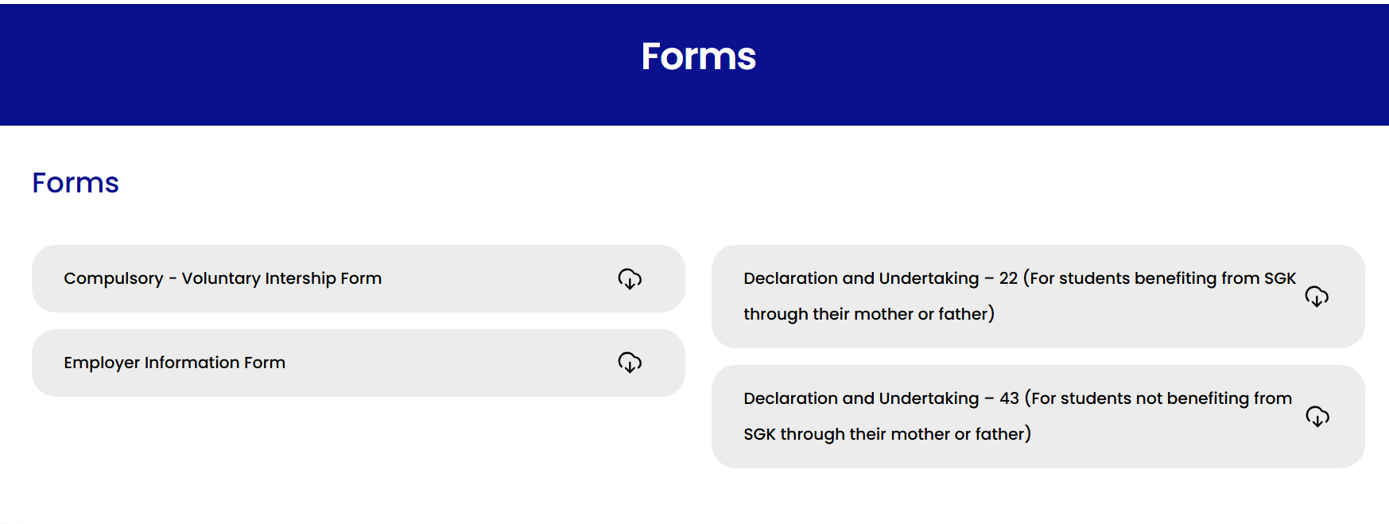
A student selected for internship by a company;
should download 1 internship form, 1 employer information form, and 1 https://www.isikun.edu.tr/ogrenci/staj-isleri-birimi/formlar

Slide 3
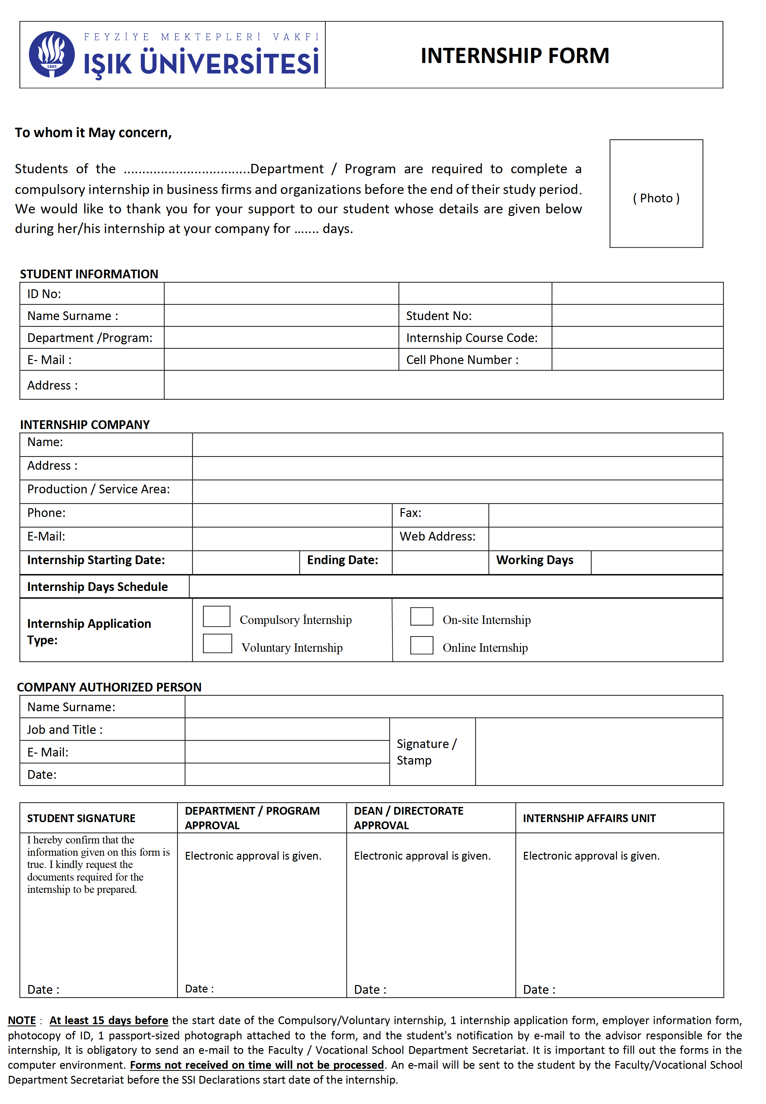
STEP 1: Filling in Internship Form fields
On the downloaded form;
1. In the first paragraph, enter the student's department and the total number of internship days in the designated spaces, respectively.
2. ‘Fill in all required fields in the "Student Information" section.
Internship Codes: 190:
290 : 1st Compulsory Internship (Prerequisite)
390 : 2nd Compulsory Internship (Post-prerequisite)
3. Complete the "Internship Company" section. This can be filled out by either the student or the organization
4. Enter the internship start and end dates as agreed upon with the company. Specify the total duration clearly in terms of working days.
5. In the "Internship Days" section, indicate which days of the week the internship will be performed.
6. Under the internship application type section, select whether the internship is compulsory or voluntary.
7. Complete the "Employer or Authorized Person" section and ensure it is finalized with the authorized official's signature and official company stamp and seal.

Slide 4
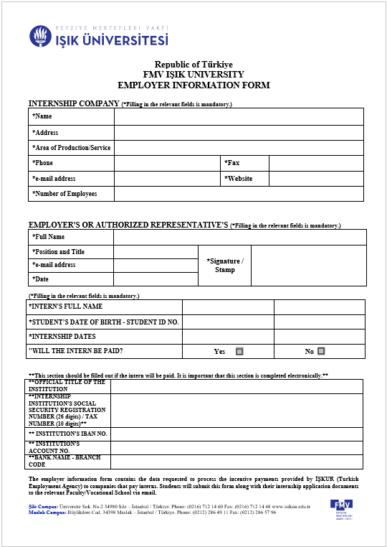
STEP 2: Filling in Employer Information Form fields
On the downloaded form;
1. The employer must complete all requested company data in the ‘Internship Company’ section.
* The ‘Number of Employees field’ is critical and must not be left blank.
2. The employer must fill in the required data in the ‘Employer or Authorized Representative’ section.
3. The employer must select whether the intern will be paid or unpaid by checking the appropriate box.
4. If the payment option "Yes" is selected, the employer must provide the company's bank account information clearly and in full.
5. If the payment option "No" is selected, the bank information section may be left blank.
6. The student is responsible for ensuring all their own personal information on the form is filled out completely.
7. Once all data is entered, the employer must stamp and sign the form to authorize the document.

Slide 5
STEP 3: Internship Form signature stages
In the final signature section of the data entry form;
1. ‘The "Student Signature’ section must be signed by the student.
2. The form is sent by email to the student’s academic advisor of the relevant department for “Department/Program Approval”. If the internship is deemed suitable by the internship coordinator, the student receives the approval email or electronic signature.
3. For “Dean’s / Directorate Approval,” the student sends an email to the department secretary with the approval received from the internship coordinator. The department secretary submits it to the Faculty Dean for approval via the EBYS system. Electronically signed documents are then forwarded by the Dean’s Office to the Internship Unit.
4. Based on the approved EBYS document, the Internship Unit processes the Social Security (SGK) procedures. They then finalize the process via EBYS and forward it to the Dean's Office to ensure the SGK declarations are emailed to the students.

Slide 6

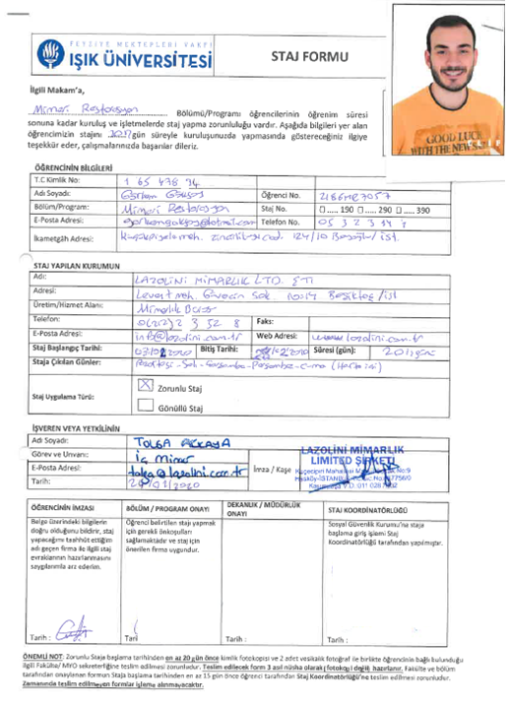


One copy of the form must be prepared, and all approvals must be completed.

Slide 7
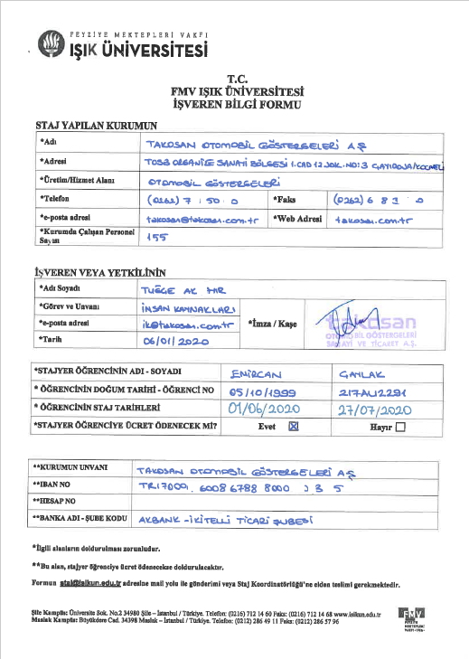


İŞKUR provides financial incentives to companies that pay intern wages during their internship period, offering partial reimbursements to the employer. To remain eligible for these incentives, all information on this form must be filled out accurately and legibly.

Slide 8
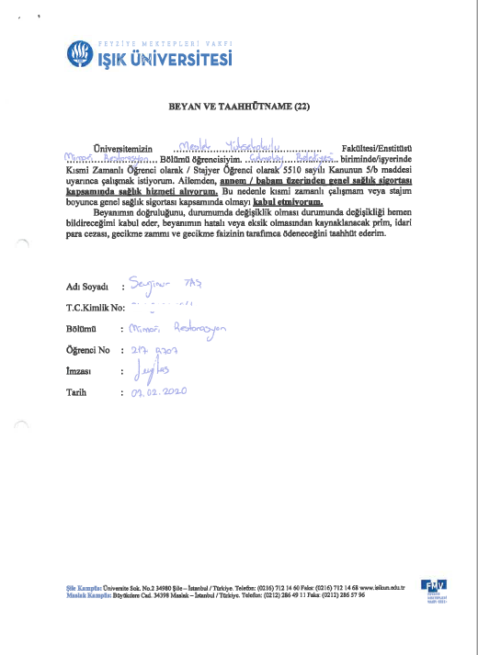


Students who receive healthcare benefits through their parents (Mother or Father) under the coverage of the Social Security Institution (SGK) must complete and sign the Declaration and Undertaking Form (22).

Slide 9
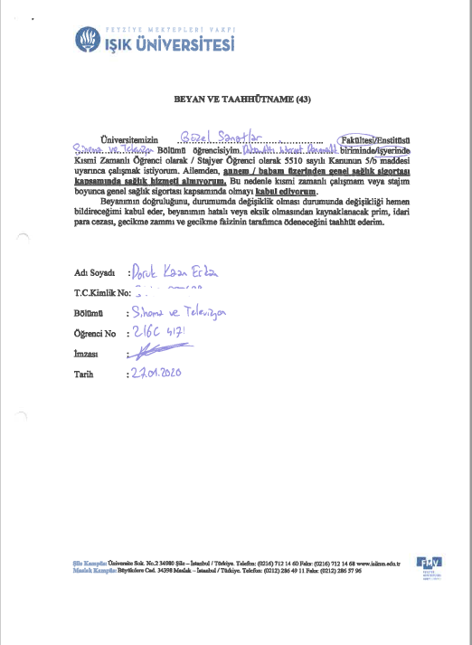


Students who do not receive healthcare benefits through their parents (Mother or Father) under the coverage of the Social Security Institution (SGK) must complete and sign the Declaration and Undertaking Form (43).

Slide 10
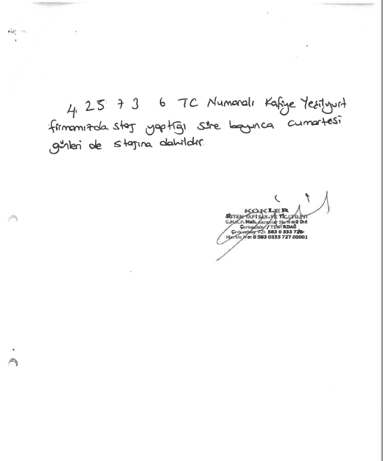
If the internship includes weekend work, a confirmation letter signed and stamped by the company must be provided. This document must be submitted to the Department Secretariat by the student along with the complete set of internship paperwork.

Slide 11
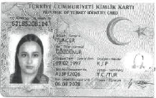
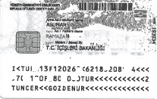
A photocopy of the identity card (ID) must be included with the application documents.

Slide 12
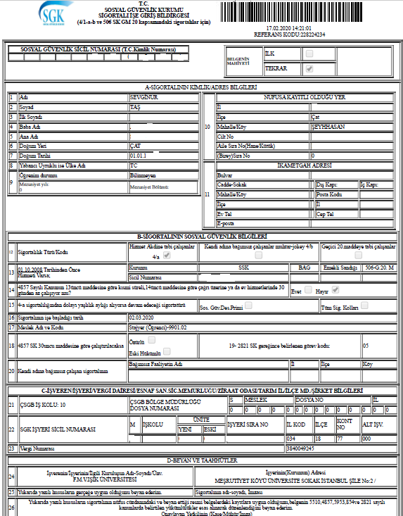


After completing the student's Social Security (SGK) registration, the Internship Unit forwards the SGK Statement of Employment to the Dean's Office/Directorate via EBYS. The Department Secretariat then emails the SGK statement and EBYS approval letters to the student.
The Student → delivers one internship form, and one statement of employment , and EBYS approval letters to the company,
The Student → keeps a soft copy of all approved and finalized internship documents for their own records.
The Internship Unit;
electronically archives one internship form, one employer information form, a photocopy of Identity Card (ID), one statement of employment, and one declaration and undertaking.

Slide 13
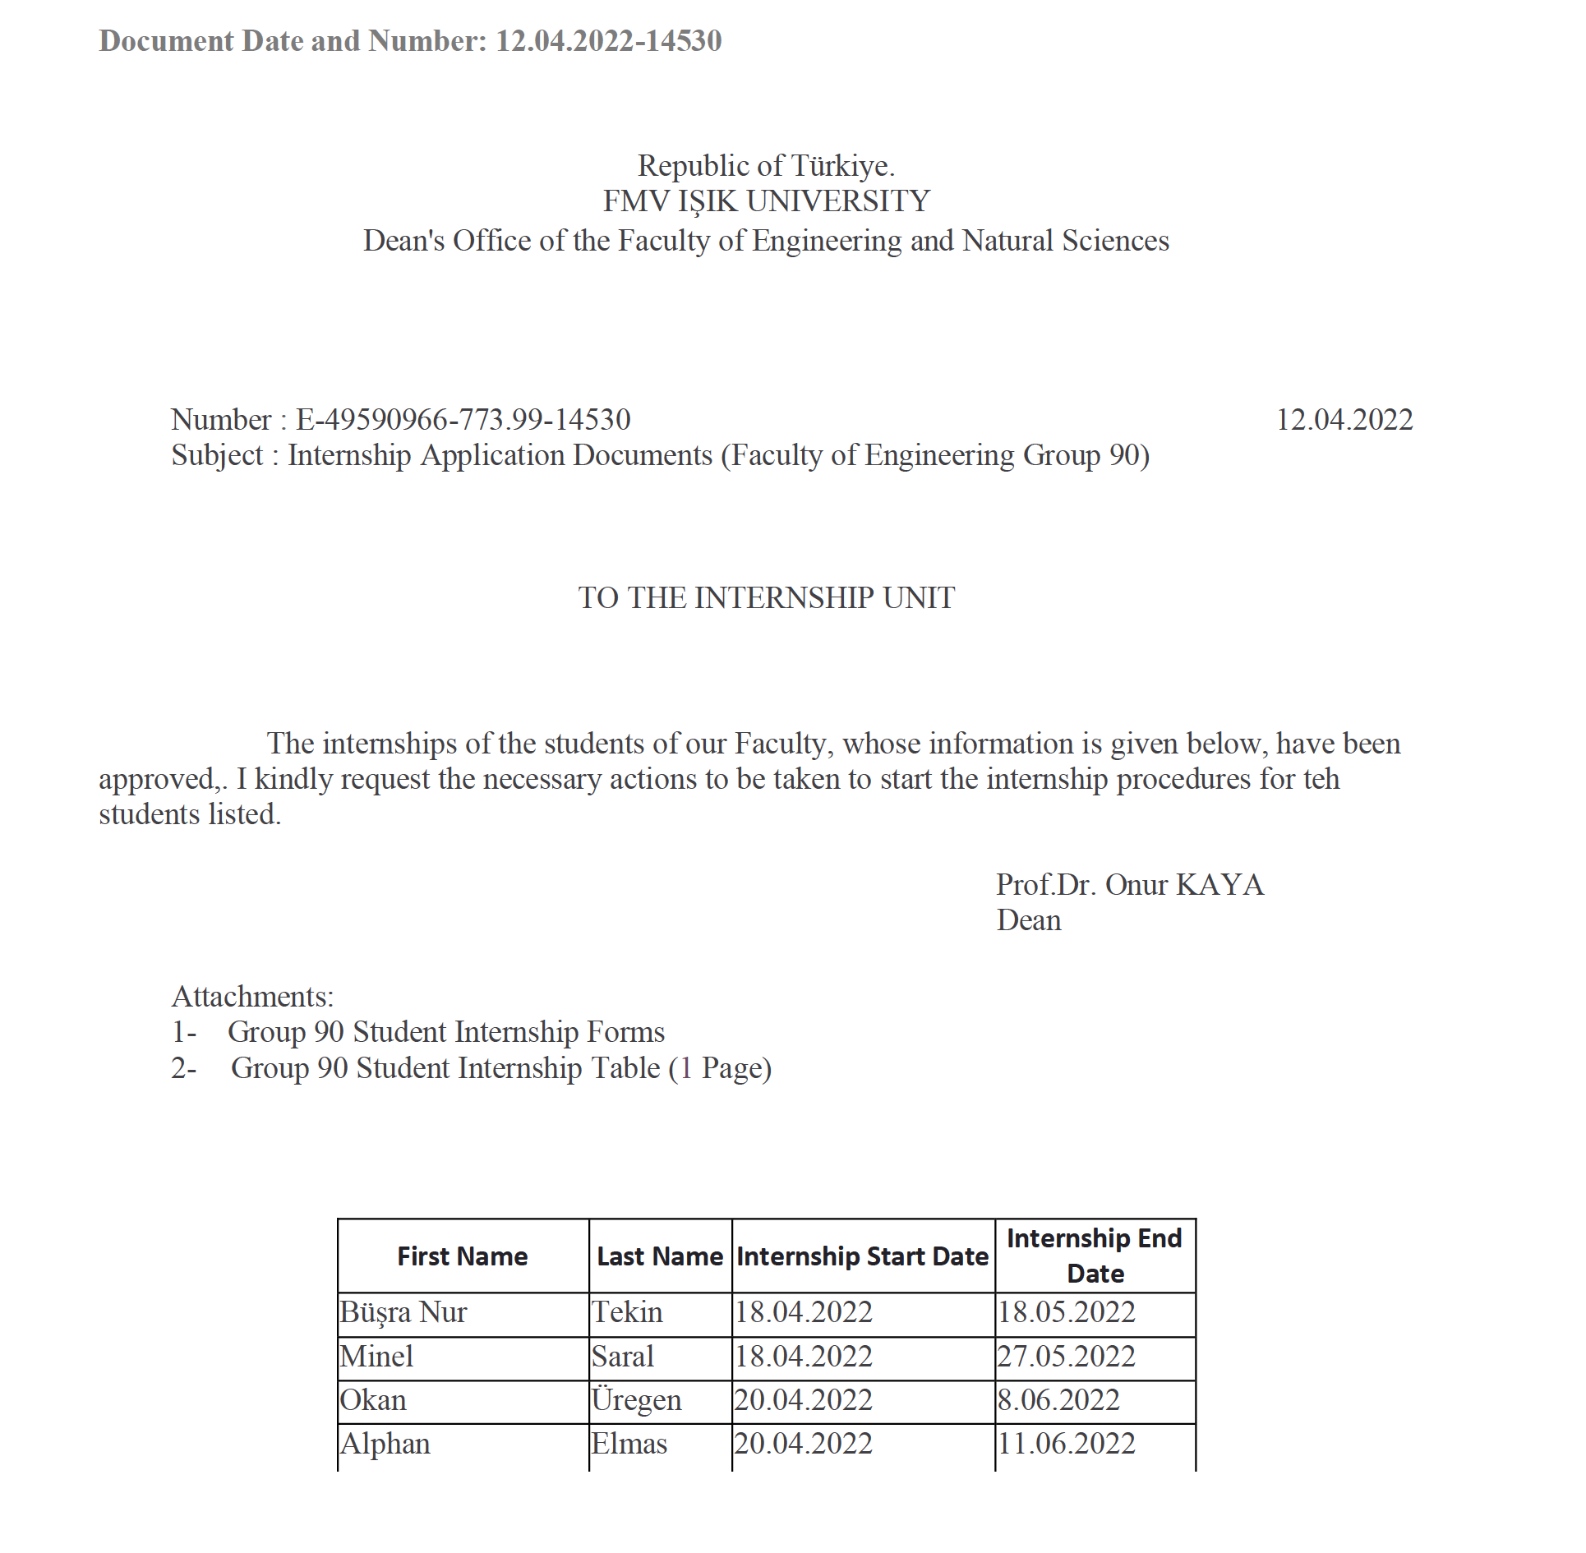

Slide 14
